Slide 1
Exoplanets and Habitability
By: Jannah Alshazly, Konouz Abdelaziz, and Zeinab Donia

Slide 2
Table of contents
01
02
03
04
Introduction
Data
Exploration of data
Describing the topic
Describing the dataset, its main issues and limitations, and how we overcame it.
Showing visualizations and insights
Conclusions
What is the overall conclusion of the insights.

Slide 3
—Konstantin Tsiolkovsky, pioneer of Russian rocketry.
“The Earth is the cradle of humanity, but one cannot live in a cradle forever.”

Slide 4
01
Introduction

Slide 5
Exoplanets
Planets that orbit stars other than our Sun.
Found outside our solar system

Slide 6
Are we alone?
Habitability:
The capability of a planet to support life.
Earth
This is where we all live

Slide 7
02
Data

Slide 8
Data Collection Sources
02
03
01
NASA Exoplanet Archive
NASA Exoplanet Exploration
Exoplanets and Astrobiology
Astronomical exoplanet and stellar catalog
A citizen science project, sponsored by NASA's Universe of Learning
IAC community database for exoplanet atmospheric observations

Slide 9
But the data wasn’t perfect...

Slide 10
Data Quality Problems Faced
Unconverted Data (eg RA and DEC, mass, radius etc.)
Missing Data
Data Credibility
Duplicate data
Significantly distant data
Data loss
Inconsistent/undesirable format (including typos)

Slide 11
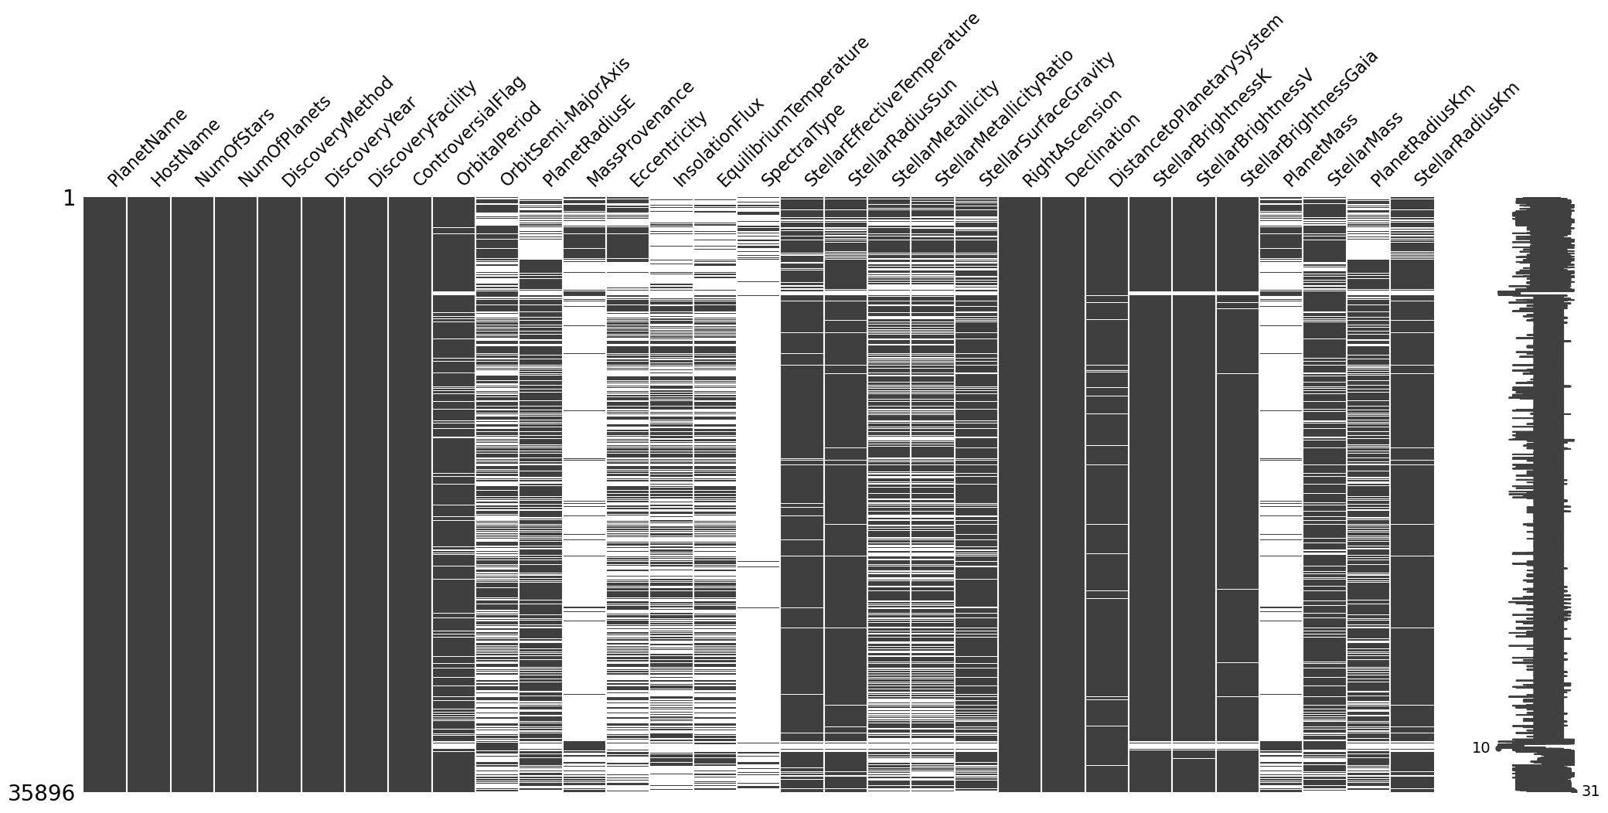
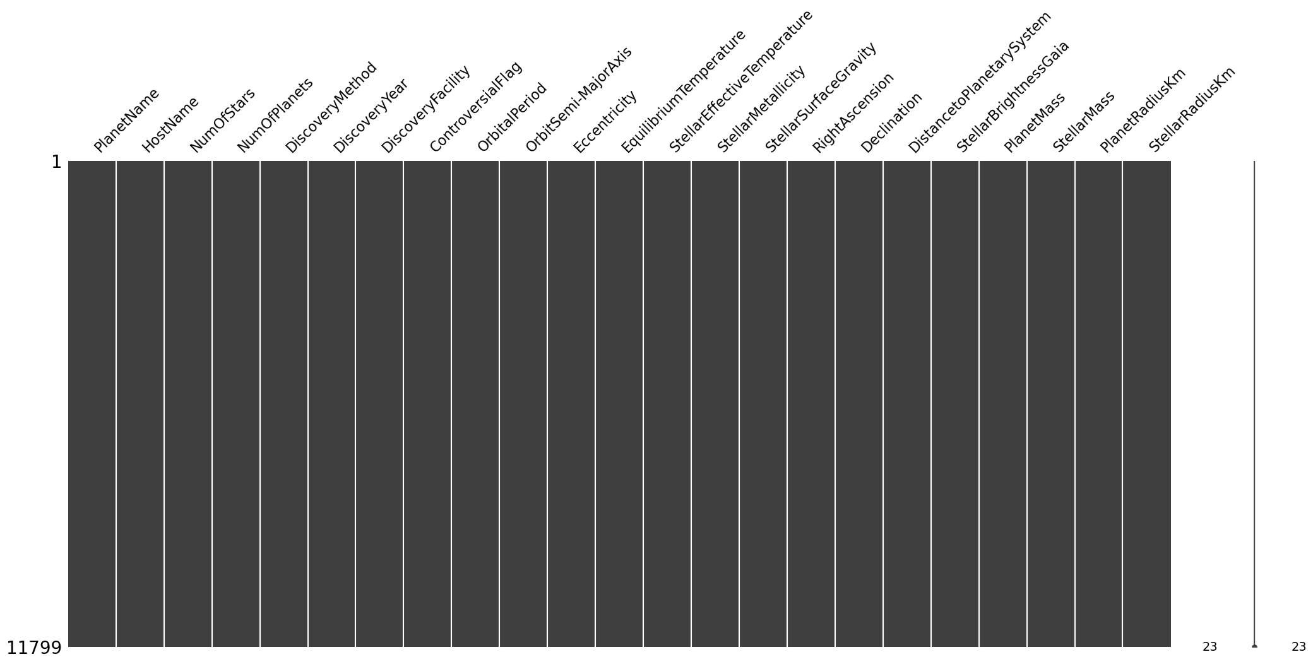
Missing Data
Imputation using either calculation or prediction.
Removal of records or columns.

Slide 12
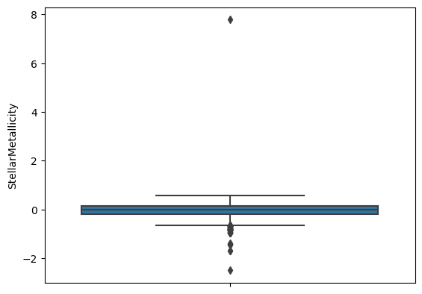
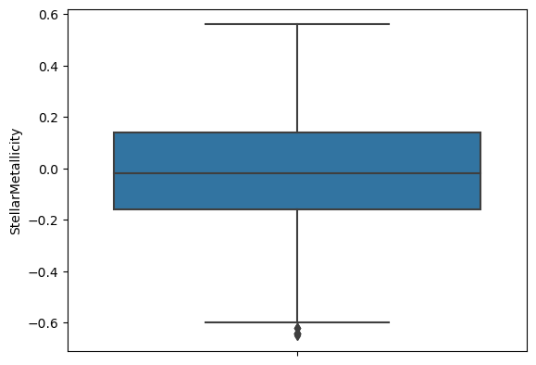
Significantly distant data
Box plots

Slide 13
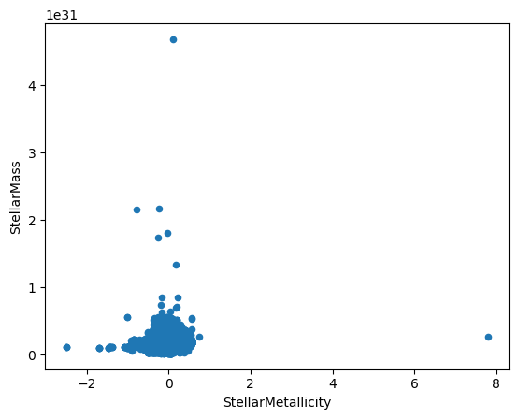
Significantly distant data
Scatter plot

Slide 14
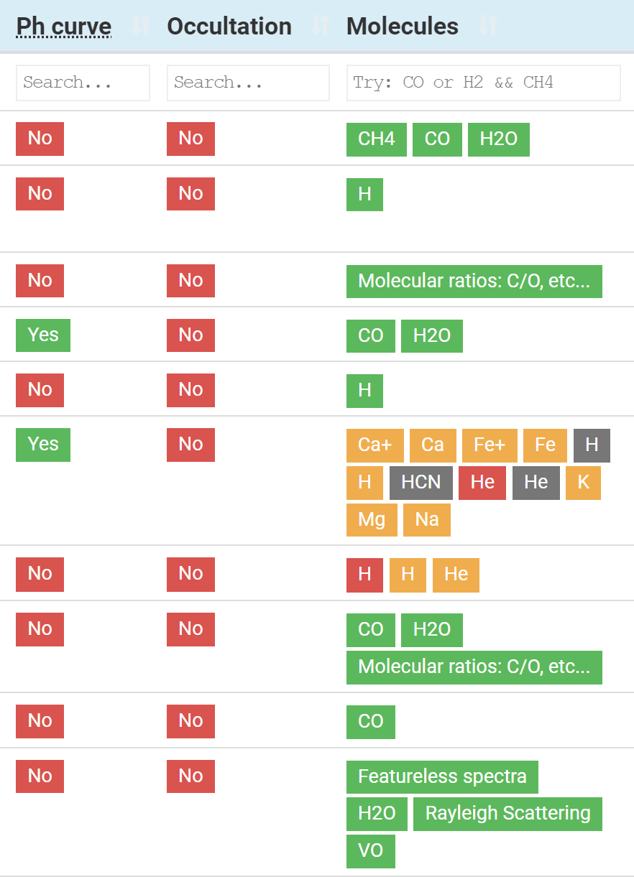
Data Limitations
Concentration of molecules found not specified.
Occulation and Ph curve unclear.

Slide 15
03
Data Exploration and Visualization

Slide 16
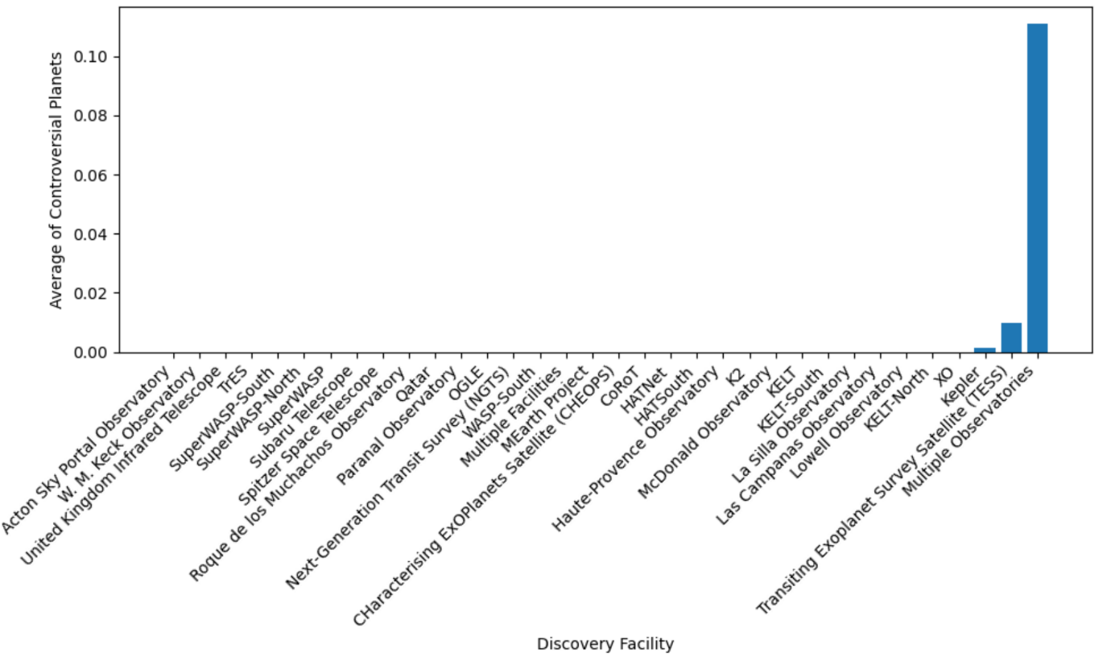
Exoplanet Detection and Controversy
Question 1: Does the discovery facility used to find the planets affect the controversial flag?

Slide 17
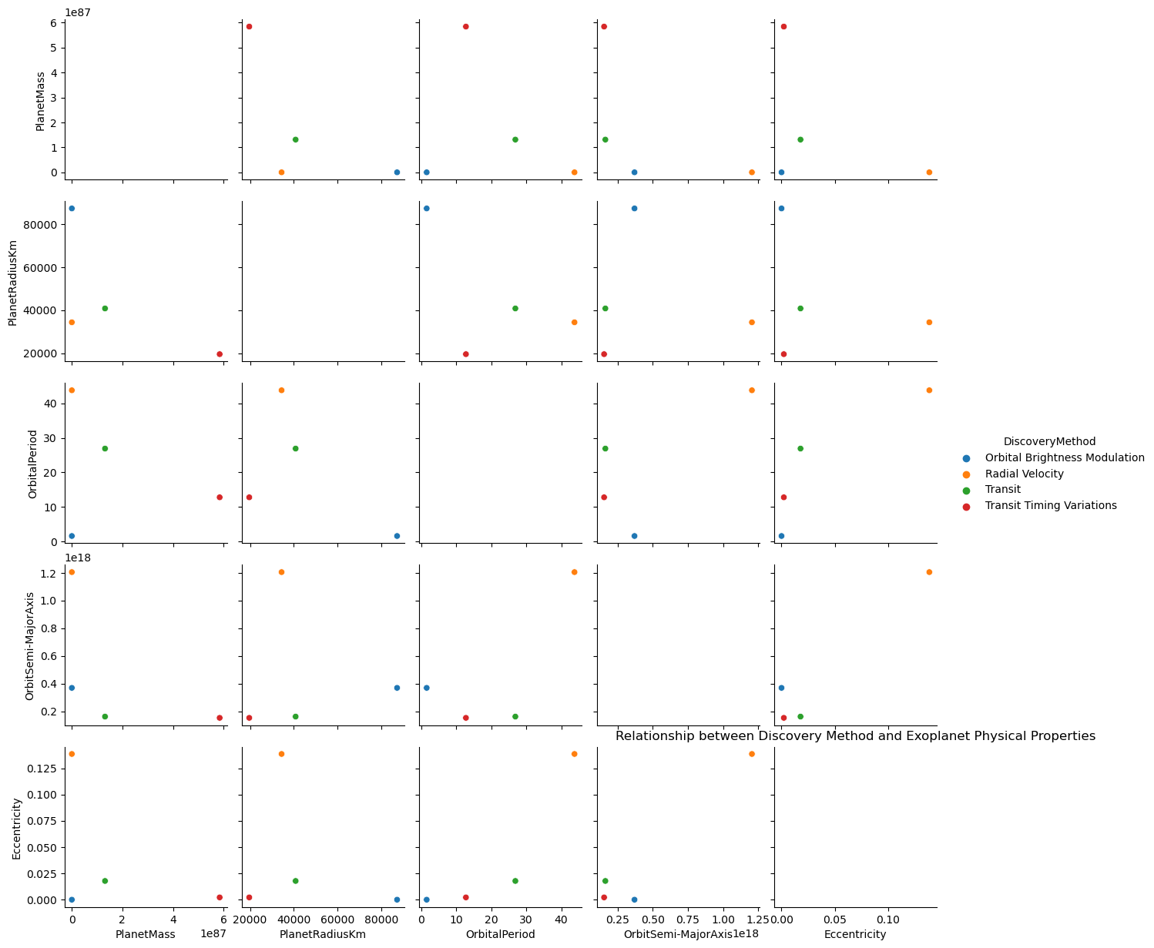
Physical Properties and Discovery Methods
Orbital Brightness Modulation
Radial Velocity
Transit
Transit Timing Variations
Question 2: Do the physical properties of exoplanets affect how they are discovered?

Slide 18
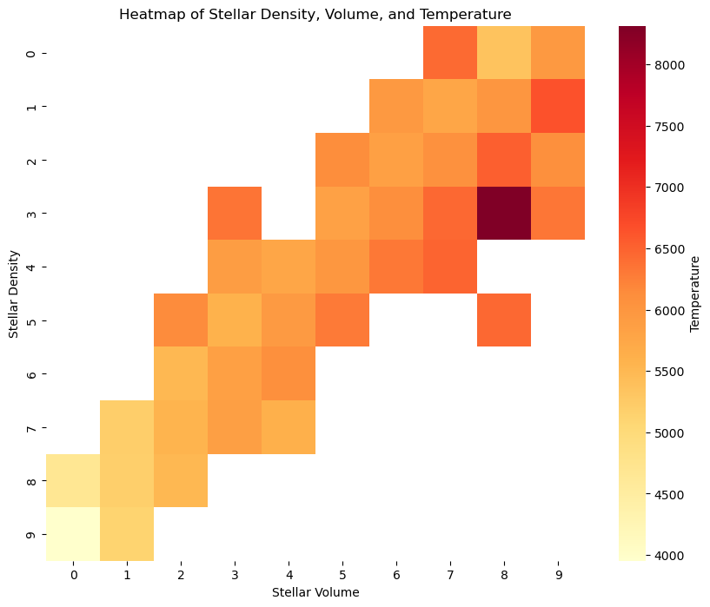
Stellar Characteristics
Question 3: Do larger and denser stars have higher temperatures?

Slide 19
Habitability
When searching for possibly habitable exoplanets, it helps to start with worlds similar to our own.
But what does “similar” mean?
Calculating the habitability index
Habitable Zone
Eccentricity
Orbit Semi-Major Axis
Equilibrium Temperature
Planet Gravity
Atmospheric Composition

Slide 20
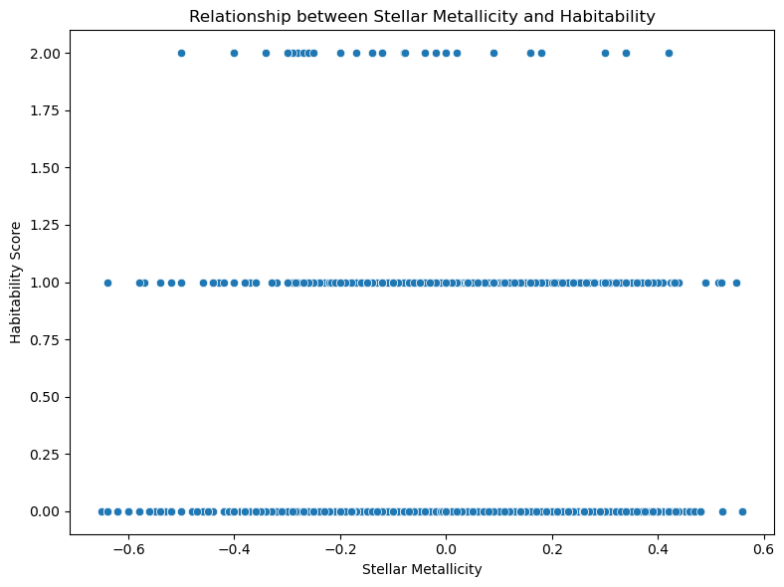
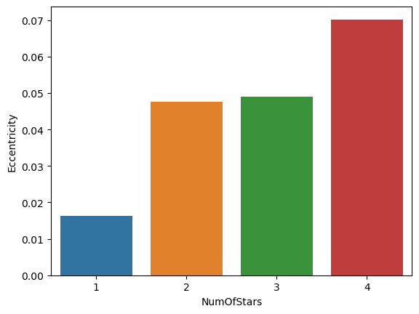
Stellar Characteristics and Habitability
Question 4: Does the star metallicity dictate whether the exoplanets are more habitable or not?
Question 5: Does having more stars in a planetary system impact the eccentricity of their hosted exoplanets?

Slide 21
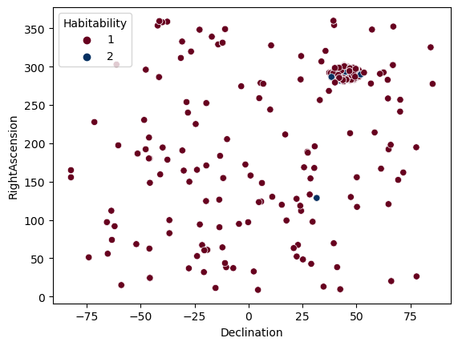
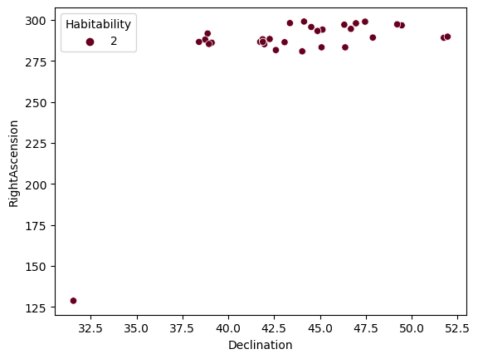
Distribution and Clustering of Habitable Exoplanets
Question 6: Do habitable exoplanets tend to exist within specific areas of our universe?

Slide 22
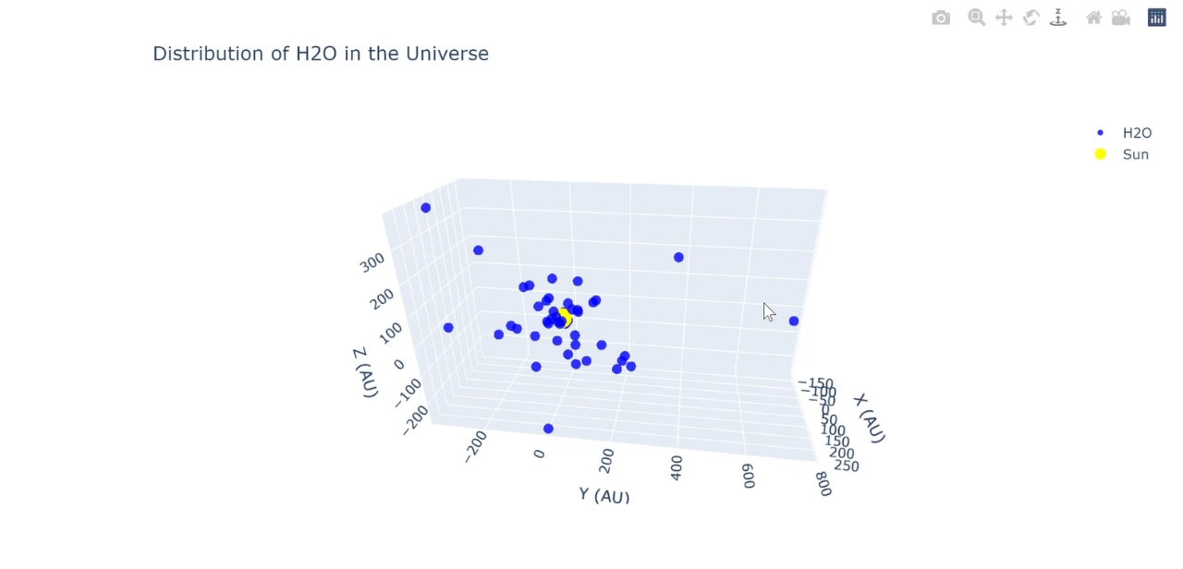
Atmospheric Composition and Habitability
Question 8: What molecules are most prevalent in which regions of the universe?

Slide 23
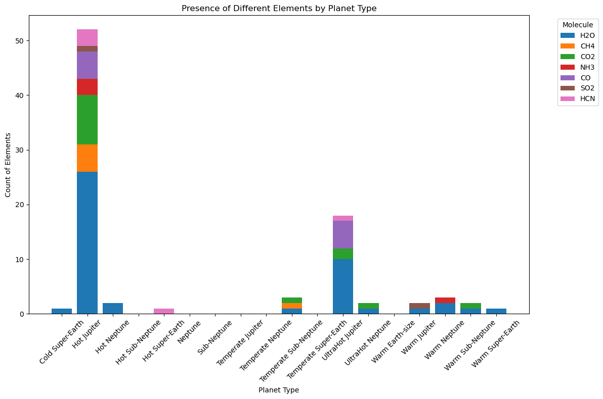
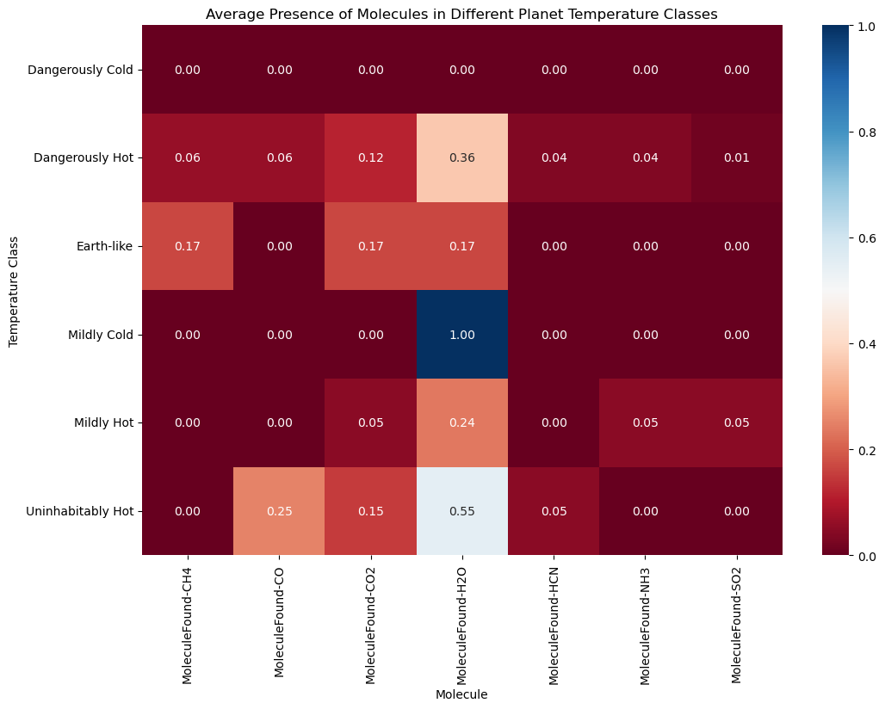
Planet Characteristics and Atmospheric Composition
Question 9+11: Does planet type or temperature determine the atmospheric composition of exoplanets?

Slide 24
04
Conclusion

Slide 25
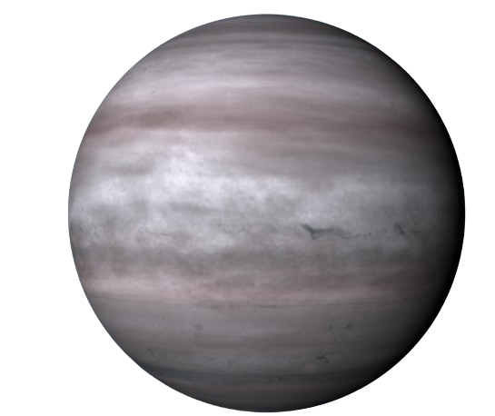
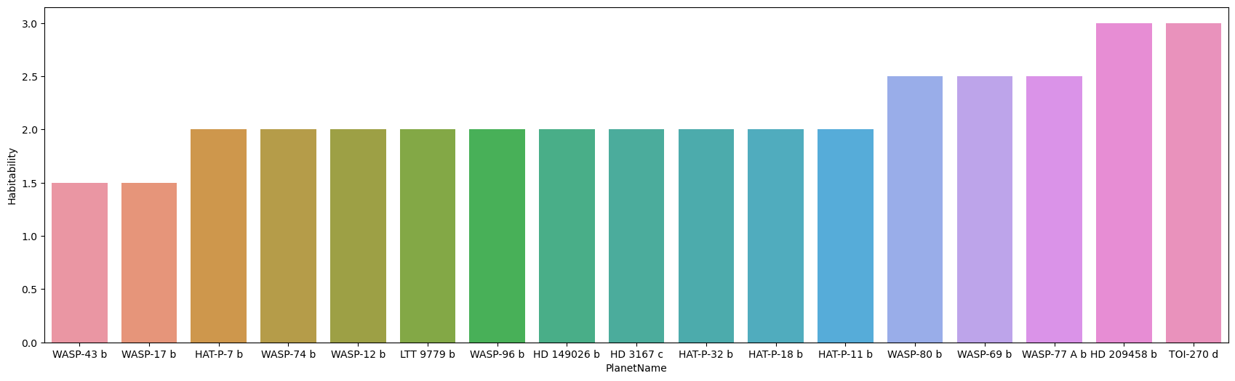
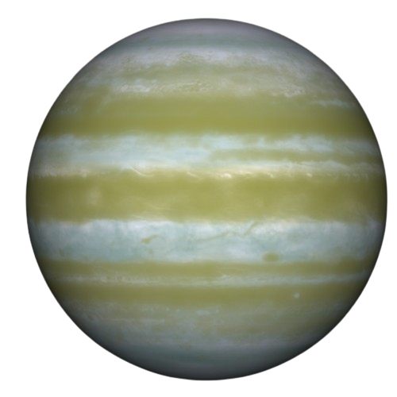
Most Habitable Planets Found
HD 209458 b
TOI-270 d

Slide 26
In conclusion, we’ve obtained a wide variety of insights from the data, delving into details such as:
Discovering trends in the physical exoplanet and stellar properties
Determining which planets could be considered most habitable
Identifying most accurate exoplanet discovery methods and facilities
Analysing exoplanet molecular compositions

Slide 27
—Joseph Campbell
“The cave you fear to enter holds the treasure you seek.”

Slide 28

Thanks!

